Slide 1
Analysis of Temperature shocks and Economic Growth on 21st Century data
Submitted by Uday Agarwal 18817828

Slide 2
Objective
Panel data analysis of temperature shocks on GDP per capita growth.
To test the hypothesis that temperature shocks do not affect the economic growth.

Slide 3
Justification
Replication of the work by Melissa Dell, Benjamin F. Jones, and Benjamin A. Olken (2021)
The time period used from 2006-2020 and 71 countries under consideration.
Temperature and output are very related in extreme heat/ cold the productivity of humans decrease thus resulting in poor economic growth.
Used the baseline panel data equation of the above work

Slide 4
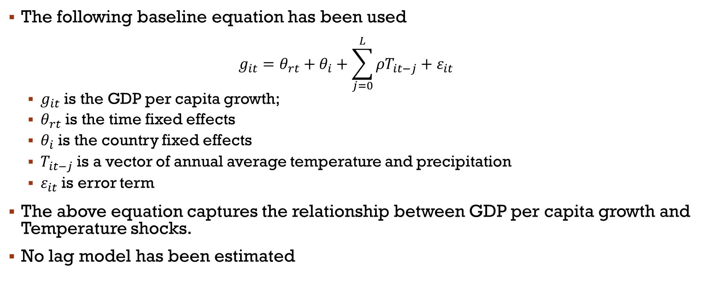
Methodology
The following baseline equation has been used $g_{it}=θ_{rt}+θ_{i}+\sum_{j=0}^{L}{ρT_{it−j}+ε_{it} }$
$g_{it}$ is the GDP per capita growth;
$θ_{rt}$ is the time fixed effects
$θ_{i}$ is the country fixed effects
$T_{it−j}$ is a vector of annual average temperature and precipitation
$ε_{it}$ is error term
The above equation captures the relationship between GDP per capita growth and Temperature shocks.
No lag model has been estimated

Slide 5
Methodology
Hypothesis tested on without any conditions
We then add poor country dummy and precipitation as control variable
Poor countries are defined as countries with PPP adjusted GDP per capita lower than the median
Hot countries are defined as countries with average annual temperature greater than mean temperature of the year.

Slide 6
Data
The mean annual temperature and precipitation data used in this paper has been taken from world bank’s climate change knowledge portal.
Data for GDP per capita growth, PPP adjusted GDP per capita has been taken from World Bank.
The temperature, precipitation and growth indicator data has been taken for years 2006-2020.

Slide 7
Observation Table
====================================================
Dependent variable:
---------------------------------------
growth_per_capita
(1) (2) (3) (4)
----------------------------------------------------
mean_temp -0.863*** -0.825*** -0.794*** -0.794***
(0.299) (0.300) (0.303) (0.303)
poor_dummy -0.747* -0.749* -0.749*
(0.425) (0.425) (0.425)
preci 0.001 0.001
(0.001) (0.001)
----------------------------------------------------
Observations 1,080 1,080 1,080 1,080
R2 0.008 0.011 0.012 0.012
====================================================
Note: *p<0.1; **p<0.05; ***p<0.01
Table 1 Panel Data Results

Slide 8
Findings
The first column shows negative and statistically significant coefficient for the temperature variable, through this we can say that higher the temperature lower is the growth rate of a country.
In the second column we add poor country dummy. The result we obtain from the regression are like what we see in the paper suggesting a substantial heterogeneity between poor and rich countries.
Precipitation data is added as control variable shows mild effects of precipitation on GDP growth.
Further we add dummy for hot country.
We find a very high correlation between mean temperature and hot dummy

Slide 9
Conclusion
Analyzed the impact of temperature shocks on economic growth.
Ran a panel data regression of 71 countries for the period 2006-2020.
Rejected the null hypothesis that temperature does not affect the economic growth of a country
The results of this regression and base paper we find similar results in terms of effect of temperature on economic growth

Slide 10
Challenges
Finding and collating temperature and precipitation data was difficult and a bit redundant task.
Never had a hands-on experience on fixed effects model and thus learning the application of this kind of model was a new thing for me.

Slide 11
References
Dell, M., Jones, B.F. and Olken, B.A., 2012. Temperature shocks and economic growth: Evidence from the last half century. American Economic Journal: Macroeconomics, 4(3), pp.66-95.
https://climateknowledgeportal.worldbank.org/download-data (for precipitation and temperature data)
https://data.worldbank.org/ (for growth indicator data)

